Slide 1

Hybrid Work
Strategies for organisations
Notes:
hello@geniosity.com.au
1300 338 325
www.geniosity.com.au

Slide 2
Navigating the new normal
80%
v
of managers expect more flexible work arrangements post-pandemic¹
73%
v
Recent research indicates the impacts of hybrid work—and suggests approaches for the future.
of employees want flexible remote work options to stay¹
54%
v
of employees feel overworked¹
79%
v
of surveyed enterprises experienced a cyber breach in the past year with an average cost of $4.72M per data breach²
Source: Microsoft’s annual Work Trend Index, March 2021. 2 Forrester Study: The 2020 state of security operations ​(Commissioned by Paolo Alto Networks)

Slide 3
A holistic approach
Every function will need to come together—to reimagine how to empower employees, engage customers, optimize operations, and cultivate innovation.
People
Places
Processes

Slide 4
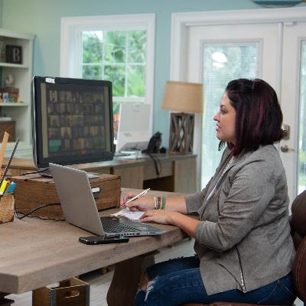

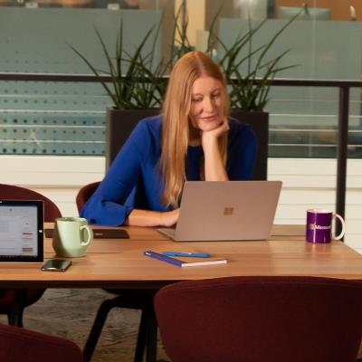
Always-on culture
at home
on the go
Supportive operations help employees thrive—instead of burn out.
at the office

Slide 5
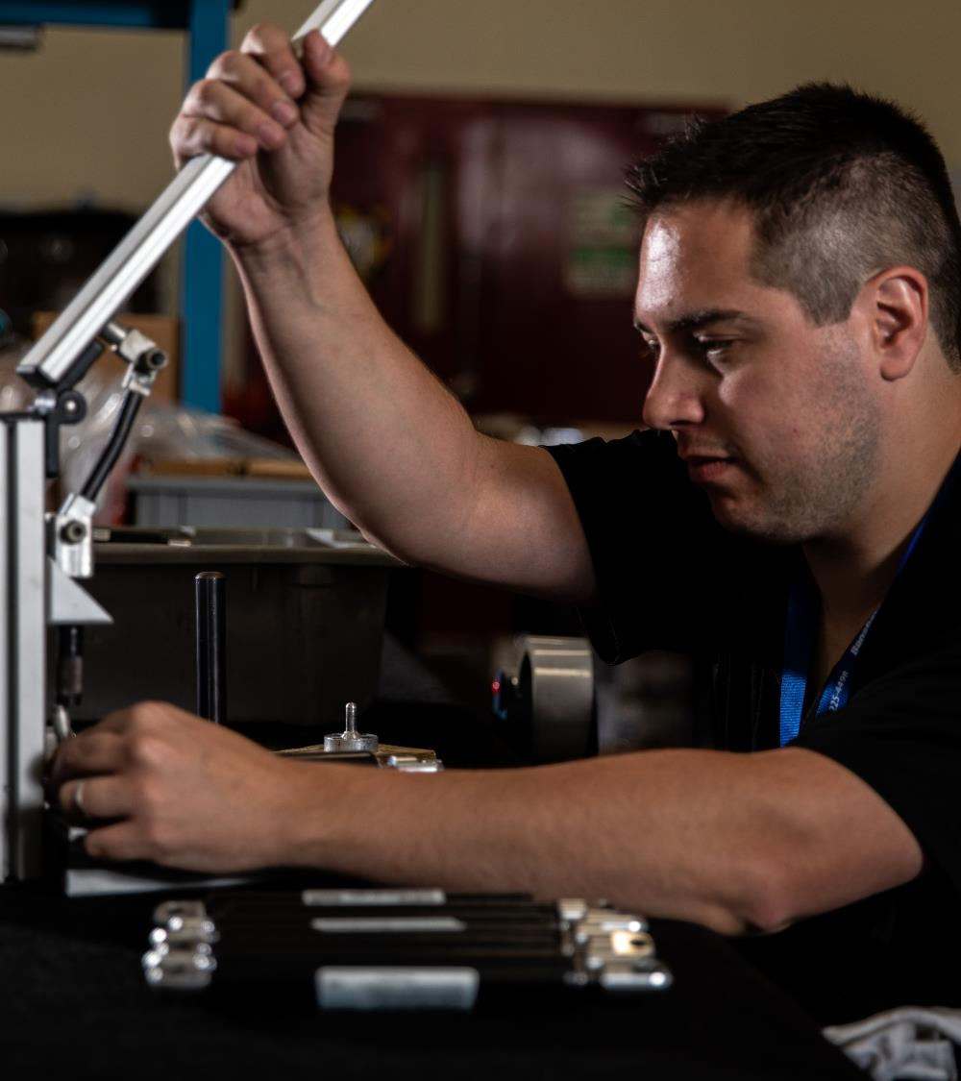
Pressure on the frontline
The health & safety, productivity, and satisfaction of frontline workers fuels brand reputation.

Slide 6
Reinventing when, where, and how people work
People
Places
Processes
Employees expect to connect and collaborate from anywhere, on any device
Workspaces—including the frontline—need to facilitate inclusion and productivity
Solutions must be cost-effective and streamlined, while supporting work-from-anywhere security

Slide 7
Common concerns across our global customer base
Assessing the challenges of hybrid work…
Employee disengagement
Frustrated employees
Disconnection from company culture, mission, & strategy
Rising employee burnout, intensified by pandemic
Too much time spent searching for experts or information
Manual workforce management due to lack of digital access to schedules
Inadequate communication with headquarters, worsened by the pandemic
Stalled productivity from manual, outdated processes
Tech processes
End-user productivity impacted by limits of traditional solutions
Security & compliance risks from fragmented tools, unmanaged apps, personal devices, and legacy solutions
IT continually managing evolving needs with reduced budgets
Device experiences
Complexities of remote deployment, management, and updates
Confusion & slowdowns from inconsistent user experiences
Unpredictable costs from constant refresh & upgrade cycles
Communication & collaboration
Inconsistent meeting effectiveness when people join from office, home, & mobile
Restrictive collaborations with traditional end-user devices & incompatible apps
Diminished connections & productivity from legacy meeting systems
Data culture
Need for insights to win cost reductions & efficiencies in unpredictable markets
Strong demand to infuse data into routine workflows & services
High cost of managing & scaling enterprise insight capabilities

Slide 8
How Microsoft helps build better outcomes
People
Places
Processes
Resilient connections to company, mission, and coworkers
Accelerated onboarding, training, & career growth
Strengthened wellbeing from improved productivity, collaboration, & job satisfaction
Standardized, more secure device experiences—from any location
Barrier-free collaboration between frontline and headquarters
Simplified, modern systems for inclusive & accessible meetings
Automated processes to improve workflows & free up IT resources
Workforce management that enables agility and saves time
Single-platform solution integrates collaborative apps & data tools—while reducing upfront costs

Slide 9
Next steps
Each business has unique priorities for hybrid work.
Let’s work together to identify the right next steps for your business.
Improve employee experiences inclusive of recruitment, retention, & wellbeing
Increase engagement & efficiency by enabling your frontline workers
Drive better decision making through business insights
Implement a modern endpoint and end-user computing strategy
Modernize communications with all-in-one calling & collaborations—for inclusive, accessible hybrid meetings for people in & outside of the room
Advance your digital estate by transitioning all IT to the cloud

Slide 10

Reliable partnership for your organisation’s unique goals
Flexible,
interoperable solutions
Exceptional
user experience
Our solutions are built on customer privacy and the global Microsoft security ecosystem.
Through flexible offerings and a consultative approach, we help organizations across industries build resilience and competitive advantage.
Built-in
security & compliance
Cost effectiveness

Slide 11
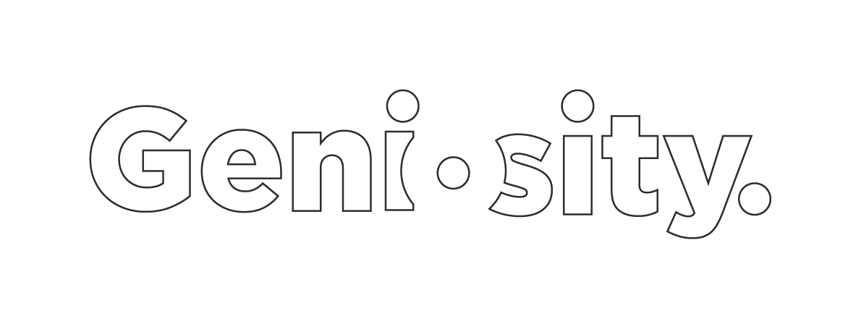
Thank you
hello@geniosity.com.au
1300 338 325
www.geniosity.com.au
Notes:
hello@geniosity.com.au
1300 338 325
www.geniosity.com.au

